Slide 1

Viewpoint and Visualisation
Chapter 7

Slide 2
7 – Viewpoints and Visualisation
7.1 Architecture Viewpoints
  7.1.1 Origin of Viewpoints
  7.1.2 Architecture Viewpoints
  7.1.3 Viewpoint Frameworks
7.2 Models, Views, and Visualisations
  7.2.1 Example: Process Illustrations
  7.2.2 Example: Landscape Maps

Slide 3
7 – Viewpoints and Visualisation
7.3 Visualisation and Interaction
  7.3.1 Actions in Views
7.4 Creating, Selecting, and Using Viewpoints
  7.4.1 Classification of Viewpoints
  7.4.2 Guidelines for Using Viewpoints
  7.4.3 Scoping
  7.4.4 Creation of Views
  7.4.5 Validation
  7.4.6 Obtaining Commitment
  7.4.7 Informing Stakeholders

Slide 4
7 – Viewpoints and Visualisation
7.5 Basic Design Viewpoints
  7.5.1 Introductory Viewpoint
  7.5.2 Organisation Viewpoint
  7.5.3 Actor Cooperation Viewpoint
  7.5.4 Business Function Viewpoint
  7.5.5 Product Viewpoint
  7.5.6 Service Realisation Viewpoint
  7.5.7 Business Process Cooperation Viewpoint

Slide 5
7 – Viewpoints and Visualisation
  7.5.8 Business Process Viewpoint
  7.5.9 Information Structure Viewpoint
  7.5.10 Application Cooperation Viewpoint
  7.5.11 Application Usage Viewpoint
  7.5.12 Application Behaviour Viewpoint
  7.5.13 Application Structure Viewpoint
  7.5.14 Infrastructure Viewpoint
  7.5.15 Infrastructure Usage Viewpoint
  7.5.16 Implementation & Deployment Viewpoint
7.6 Summary

Slide 6
7.1 Architecture Viewpoints
In this section we discuss the notion of views and viewpoints as basic tools in communicating about architectures
In the context of enterprise architectures,a viewpoint is typically used for activities like design, analysis, obtaining commitment, formal decision making, etc.

Slide 7
7.1.1 Origin of Viewpoints
The concept of viewpoint is not new. For example, in the mid 1980s, Multiview (Wood-Harper et al. 1985) already introduced the notion of views.
During the same period in which Multiview was developed,the so-called CRIS Task Group of IFIP Working Group 8.1 developed similar notions, where stakeholder views were reconciled via appropriate ‘representations’.

Slide 8
7.1.1 Origin of Viewpoints
The use of viewpoints is not limited to the information systems community,it was also introduced by the software engineering community.
In the 1990s, a substantial number of software engineering researchers worked on what was phrased as ‘the multiple perspectives problem’

Slide 9
7.1.1 Origin of Viewpoints
By this term, the authors referred to the problem of how to organise and guide (software) development in a setting with many actors, using diverse representation schemes, having diverse domain knowledge, and using different development strategies
These early ideas on viewpoint-oriented software engineering have found their way into the IEEE 1471 standard for architecture description (IEEE Computer Society 2000) on which we have based our definitions below.

Slide 10
7.1.2 Architecture Viewpoints
List some examples of stakeholders and their concerns, which could typically serve as the basis for the definition/selection of viewpoints:
  Upper-level management
  Middle-level management
  End user
  Architect
  Operational manager
  Project manager
  System developer
  System administrators

Slide 11
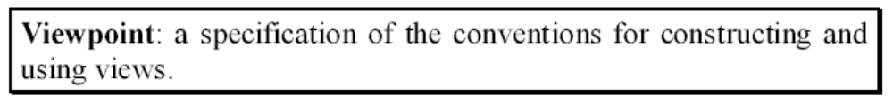
7.1.2 Architecture Viewpoints
In line with the IEEE 1471 standard, and based on the detailed definition given in Proper (2004) we define a viewpoint as follows:

Slide 12
7.1.3 Viewpoint Frameworks
These frameworks of viewpoints are: the Zachman framework (Zachman 1987), Kruchten’s 4+1 view model (Kruchten 1995), RM-ODP (ITU 1996), and TOGAF (The Open Group 2002).

Slide 13
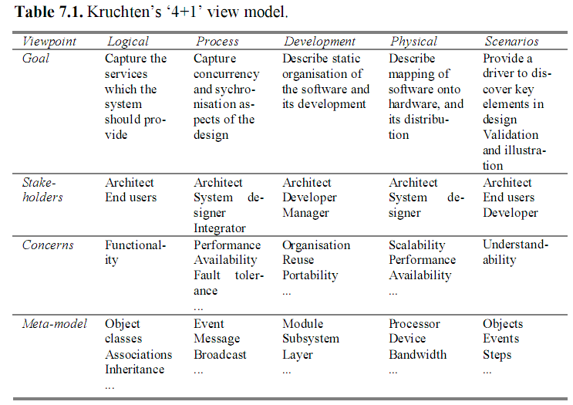
The ‘4+1’ View Model

Slide 14
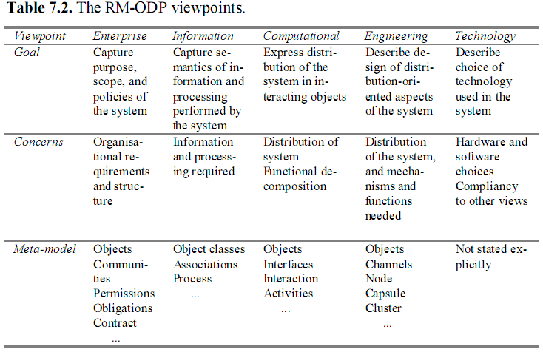
RM-ODP View Model

Slide 15
7.2 Models, Views, and Visualisations
An important principle in our approach is the separation of the content and the presentation or visualisation of a view.
The view content, referred to as the ‘view’ in the remainder of this chapter, is a selection or derivation from a (symbolic) model of the architecture, and is expressed in terms of the same modelling concepts.
The creation and update of both the view and the visualisation are governed by a viewpoint. This viewpoint is jointly defined and/or selected in an iterative process by architect and stakeholder together.

Slide 16
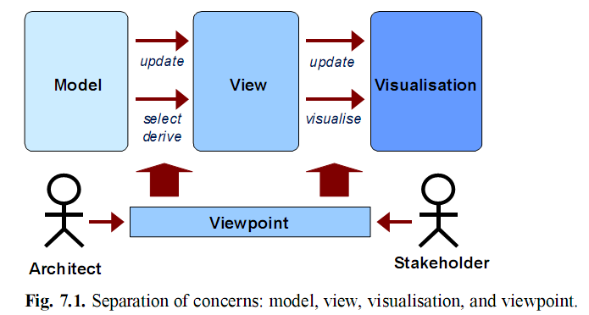

Slide 17
7.2.1 Example: Process Illustrations
To illustrate the difference between a view and its visualisation, we introduce the process illustration viewpoint.
This viewpoint illustrates a process model in an informal way for employees and managers
A process illustration is derived from a model of the architecture using a set of translation and abstraction rules.
As process illustrations are meant for communicating the coherence between business processes, they typically abstract from details regarding the applications and technology involved

Slide 18
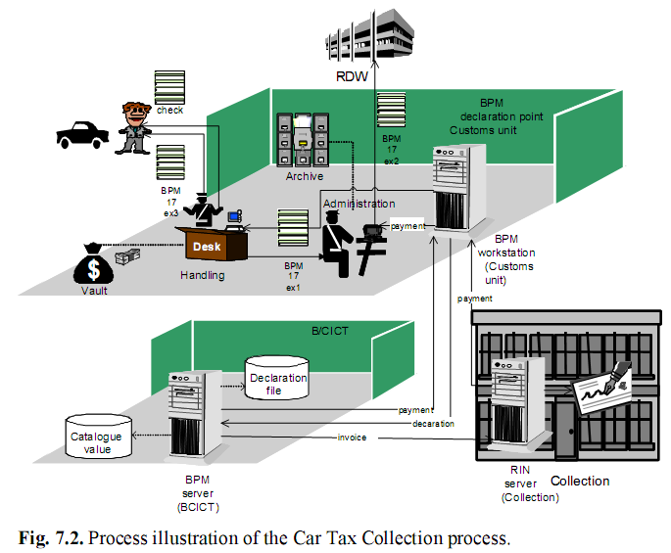
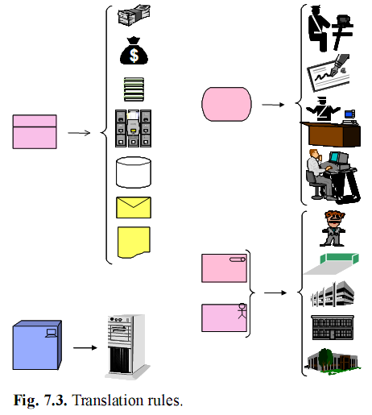
Notes:
A process illustration of the Car Tax Collection process is depicted in
Fig. 7.2. The figure shows the various subprocesses involved and the information
flows between them. The figure is derived from an ArchiMate
model via a series of translation and abstraction rules, for instance to replace
abstract shapes with meaningful symbols, abstract from complex relations,
and visually group all objects and relations that belong to or happen
within a certain actor.
In Fig. 7.3 you can see a number of presentation rules that can be applied
in the ‘model-to-illustration’ derivation. The basic idea behind these
rules is to find suitable and intuitive graphic symbols that will replace ArchiMate
shapes. These rules apply to ArchiMate concepts for which there
is an immediate correspondent in the process illustration notation (i.e., actor,
role, device, service, business object, etc.).
Of course, many other rules can be added here. For instance, rules referring
to a specific layout of the final drawing or to the more extensive usage
of 3D graphic symbols can increase the readability and usability of the final
drawing.

Slide 19
7.2.2 Example: Landscape Maps
A more complex example to illustrate the differences between a model, a view, and its visualisation, is the landscape map viewpoint.
Landscape maps are a technique for visualising enterprise architectures. They present architectural elements in the form of an easy-to-understand 2D ‘map’

Slide 20
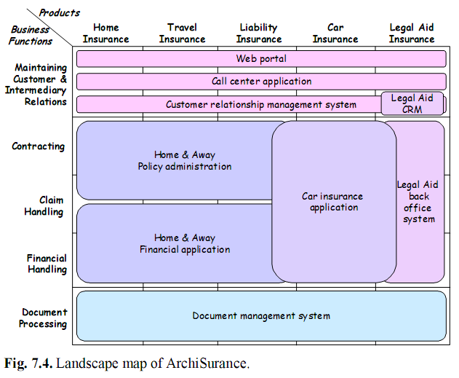
Notes:
In Fig. 7.4, a landscape
map is depicted that shows which information systems support the operations
of our fictitious insurance company ArchiSurance. The vertical axis
represents the company’s business functions; the horizontal axis shows its
insurance products. An application rectangle covering one or more cells
means that this particular function/product pair is supported by the application,
e.g., contracting of a legal aid insurance is supported by the legal
aid back-office system. The visualisation chosen makes it immediately obvious
to the viewer that there is (possibly unwanted) overlap between applications,
as is the case in the Car insurance application and the Legal Aid
CRM system. Clearly, landscape maps are a richer representation than
cross-reference tables, which cover only two dimensions. In order to obtain
the same expressive power of a landscape map two cross-reference tables
would be necessary; but even then, you would get a presentation that
is not as insightful and informative as a landscape map.

Slide 21
7.2.2 Example: Landscape Maps
Many systems used by many processes realising various products and services comprise too much detail to display in a single figure. This is a typical example of where landscape maps can help.
Summarising, in developing the landscape map viewpoint, it has been fruitful to distinguish the operation on the model from the visualisation of the view, because they are completely different concerns.
The same holds for the other viewpoints we have defined. To separate these concerns, views have to be distinguished from their visualisation.

Slide 22
7.3 Visualisation and Interaction
The distinction we make between a model and its visualisation naturally leads to the concept of interactive visualisation; that is, visualisation which can change the model due to interaction with a stakeholder.
Interaction has traditionally been considered as something completely outside the model and the view

Slide 23
7.3.1 Actions in Views
The effect of a user interacting with the visualisation can be an update of the view. But where will this be defined? Clearly, the visualisation itself is ‘dumb’ and does not know about the semantics of the view.
Hence, rules for changing the view cannot be tied to the visualisation and must be defined in the view itself. This is why we introduce the notion of actions in views.

Slide 24
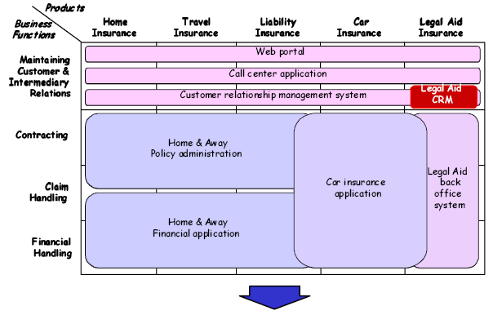

Slide 25
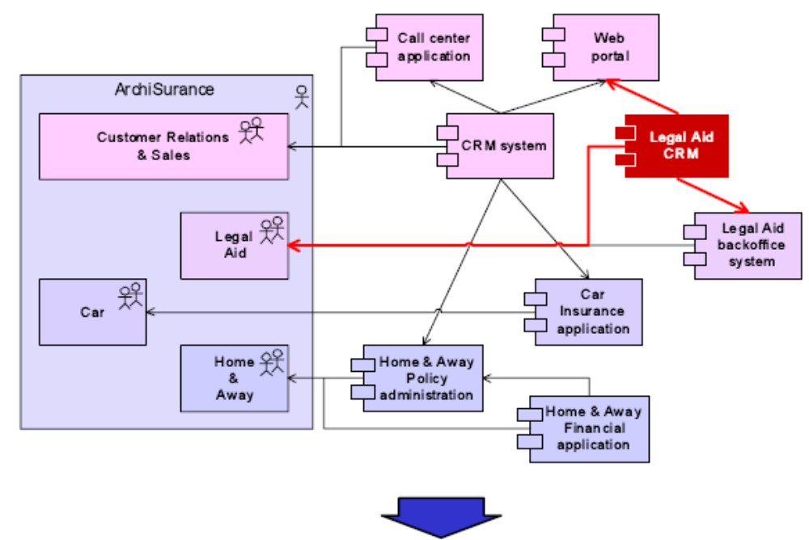

Slide 26
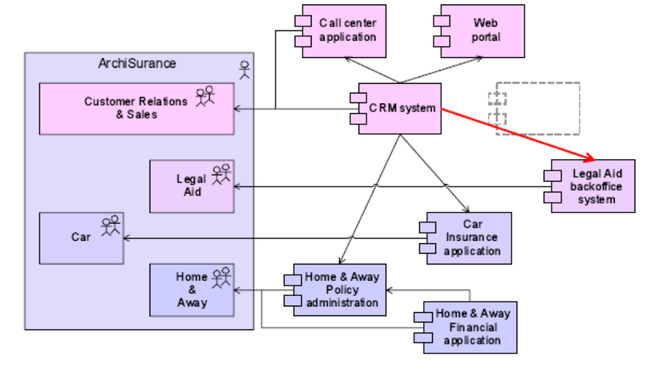
Fig. 7.5. Editing a landscape map.

Slide 27
7.4 Creating, Selecting, and Using Viewpoints
It is interesting to note that both of the discussed frameworks of viewpoints do not provide an explicit motivation for their choice regarding the modelling concepts used in specific viewpoints
Hence our attention to defining ‘ad hoc’ viewpoints relative to a predefined modelling language (i.e., meta-model) as a compromise between fixed viewpoints and free viewpoints.

Slide 28
7.4.1 Classification of Viewpoints
The following three types of architecture support define the purpose dimension of architecture views :
  Designing: Design viewpoints support architects and designers in the design process from initial sketch to detailed design
  Deciding: Decision support views assist managers in the process of decision making by offering an insight into cross-domain architecture relations,typically through projections and intersections of underlying models, but also by means of analytical techniques.
  Informing: These viewpoints help to inform any stakeholder about the enterprise architecture, in order to achieve understanding, obtain commitment, and convince adversaries.

Slide 29
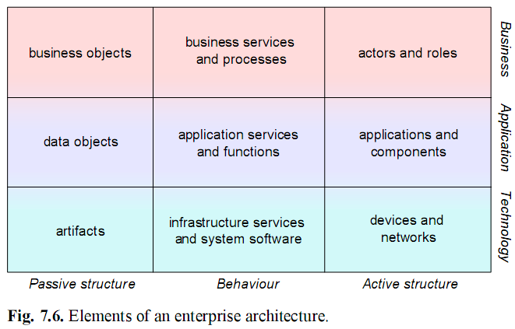

Slide 30
For characterising the content of a view we define the following abstraction levels:
  Details: Views of the detailed level typically consider one layer and one aspect from the framework
  Coherence: At the coherence abstraction level, multiple layers or multiple aspects are spanned.
  Overview: The overview abstraction level addresses both multiple layers and multiple aspects

Slide 31
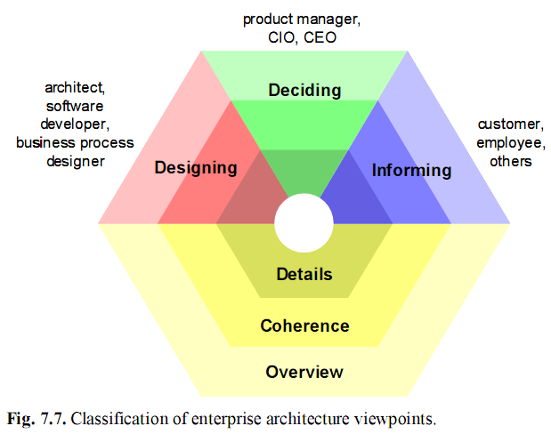

Slide 32
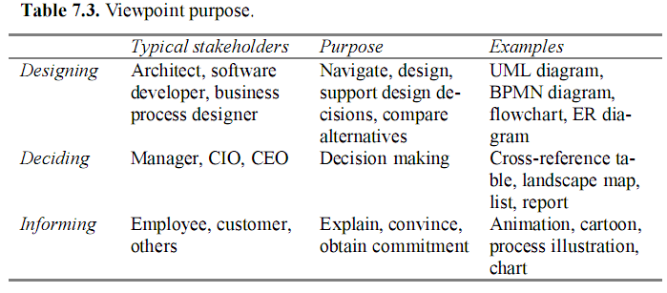

Slide 33
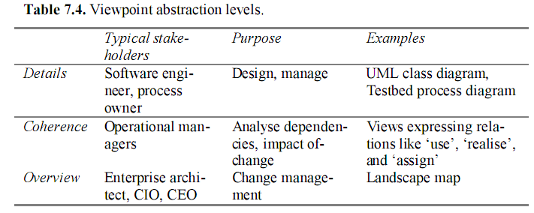

Slide 34
7.4.2 Guidelines for Using Viewpoints
In general, the use of an architectural viewpoint will pass through a umber of phases. These phases roughly are:
  Scoping: Select one or more appropriate viewpoints, select the (sub)domain that needs to be represented or modelled, and determine the constraints that apply to the domain being modelled.
  Creation of views: Create or select the actual content of the viewpoint, i.e., create or select a view conforming to the viewpoint used.

Slide 35
  Validation: Validate the resulting view
  Obtaining commitment: If agreement has been reached among the key stakeholders involved, the next step will be to create commitment for the results.
  Informing : Inform other stakeholders of the results

Slide 36
7.4.3 Scoping
The importance of focusing on the concerns of stakeholders, and the extent to which a specific view(point) addresses these concerns, was confirmed by the outcomes of the interviews
The selection of viewpoints should be done consciously and based on rational considerations. Furthermore, architects state that this decision, and its rationalisation, must be readily available.
Determining the constraints that should guide the ensuing creation phase is also considered to be important

Slide 37
7.4.4 Creation of Views
The graphical notation that is part of a viewpoint should be approached flexibly when it comes to communicating with non-technical stakeholders.
Use other forms of visualisation, text, or tables. Iconised diagrams work particularly well. However, be prepared to point out Creating, Selecting, and the relation between the alternative visualisation and your abstract models if asked to.

Slide 38
7.4.4 Creation of Views
Even if graphical models play a big role in architecture, text is the chief form in which (written) communication takes place.
Two main ways in which this occurs are:
  Graphical (partial!) models that are used to support textual descriptions (‘illustration by diagram’).
  Text explaining and elaborating on a graphical model (‘textual modelling’).

Slide 39
7.4.5 Validation
In validation of an architecture with stakeholders, a clear difference should be made between validation of content (qualitative validation, by modellers and experts) and validation in terms of commitment (by executives)
Validation is an activity that should be conducted in limited groups.

Slide 40
7.4.6 Obtaining Commitment
Obtaining commitment for a specific architectural design involves obtaining commitment for the impact of this design on the future system and its evolution, as well as the costs/resources needed to arrive at this future system.
Selecting the stakeholders that should be involved when obtaining commitment is also of key importance. Involving the wrong stakeholders, or leaving out important ones, will have obvious repercussions

Slide 41
7.4.7 Informing Stakeholders
Once commitment from the opinion leaders has been obtained, other stakeholders may be informed about the future plans and their impact
Communication is the crucial factor in enterprise architecture. It will even pay off actually to employ some communication experts (think marketing, PR, even entertainment!) in larger projects

Slide 42
7.4.7 Informing Stakeholders
As a result, you will end up with stakeholders that are genuinely prepared to change the way they and their business work, not just with some interesting looking plans and models.
Crucially, communication can be quite different for various stages of system development. Therefore, it is important to have a good communication strategy and a framework guiding you in this.

Slide 43
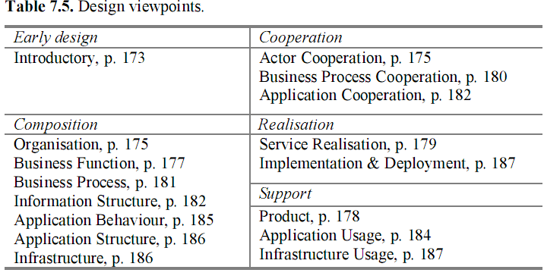
7.5 Basic Design Viewpoints

Slide 44
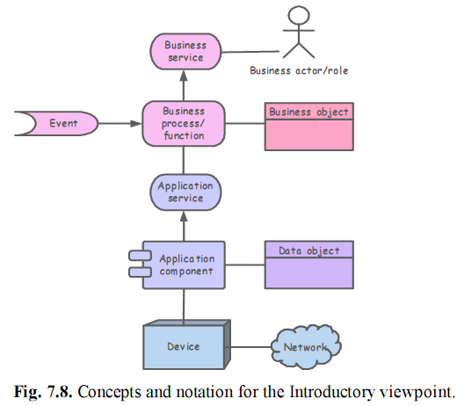
7.5.1 Introductory Viewpoint

Slide 45
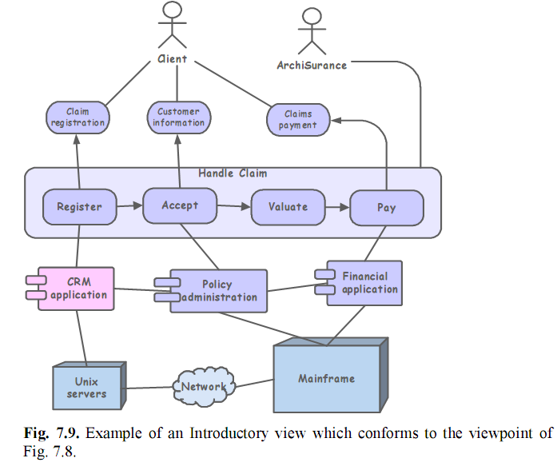

Slide 46
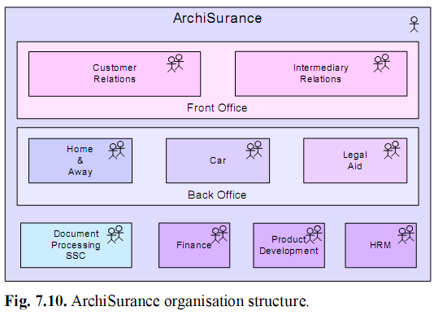
7.5.2 Organisation Viewpoint

Slide 47
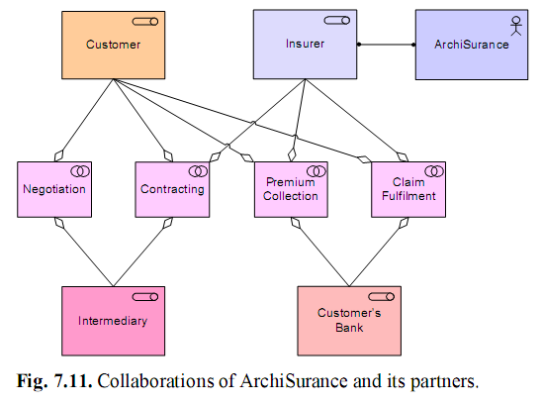
7.5.3 Actor Cooperation Viewpoint

Slide 48
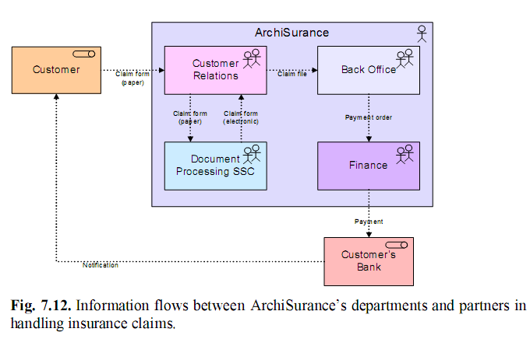

Slide 49
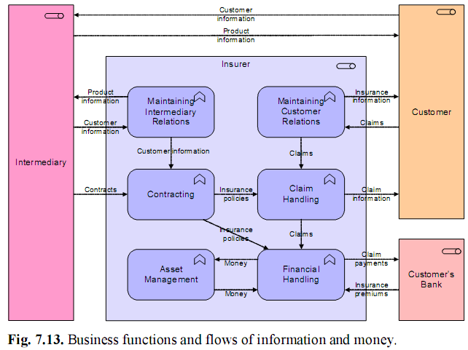
7.5.4 Business Function Viewpoint

Slide 50
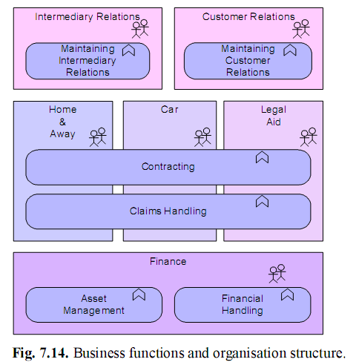

Slide 51
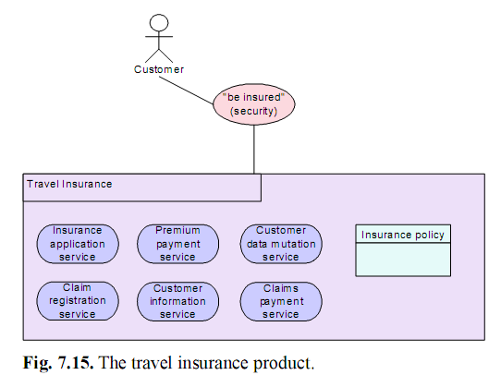
7.5.5 Product Viewpoint

Slide 52
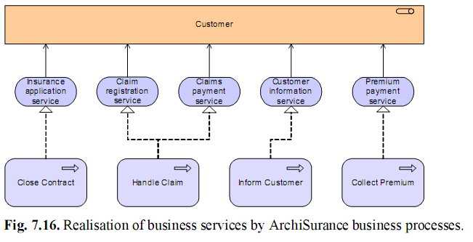
7.5.6 Service Realisation Viewpoint

Slide 53
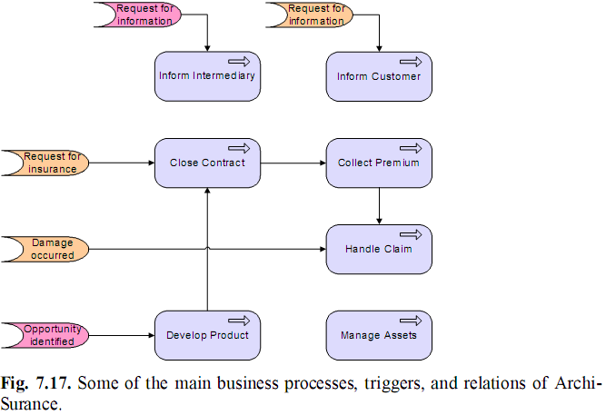
7.5.7 Business Process Cooperation Viewpoint

Slide 54
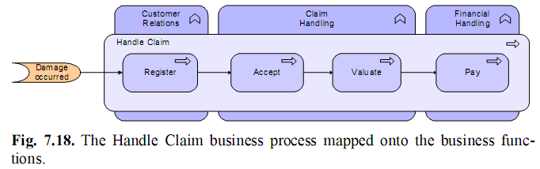

Slide 55
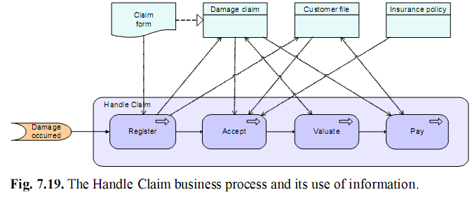
7.5.8 Business Process Viewpoint

Slide 56
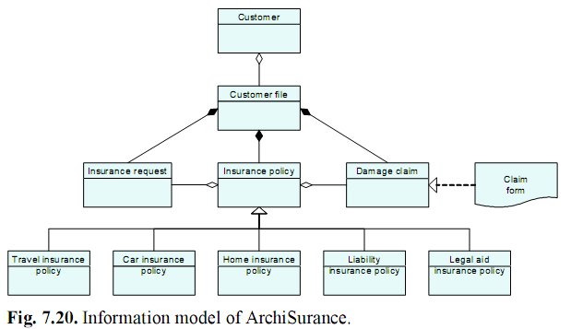
7.5.9 Information Structure Viewpoint

Slide 57
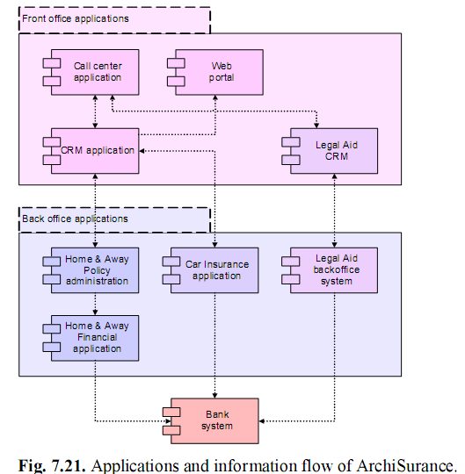
7.5.10 Application Cooperation Viewpoint

Slide 58
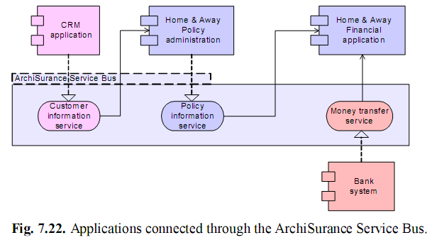

Slide 59
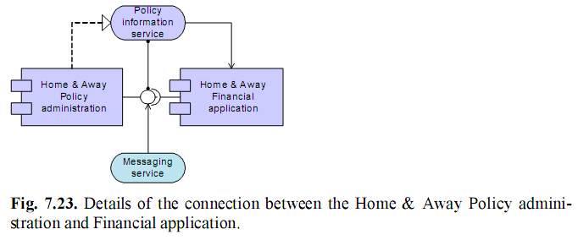

Slide 60
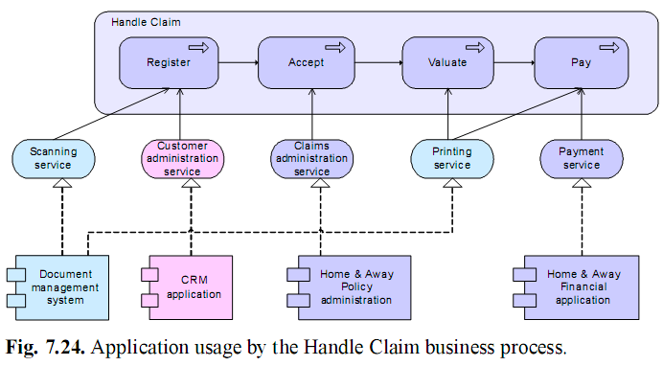
7.5.11 Application Usage Viewpoint

Slide 61
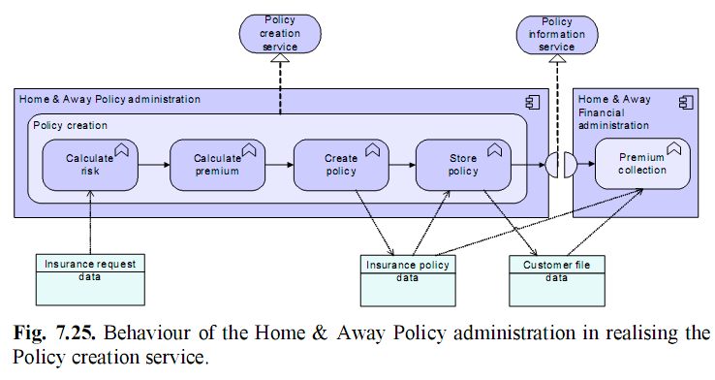
7.5.12 Application Behaviour Viewpoint

Slide 62
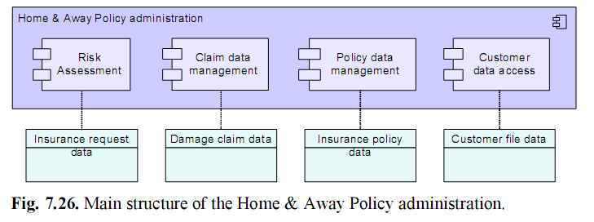
7.5.13 Application Structure Viewpoint

Slide 63
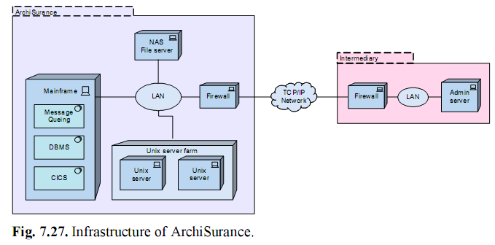
7.5.14 Infrastructure Viewpoint

Slide 64
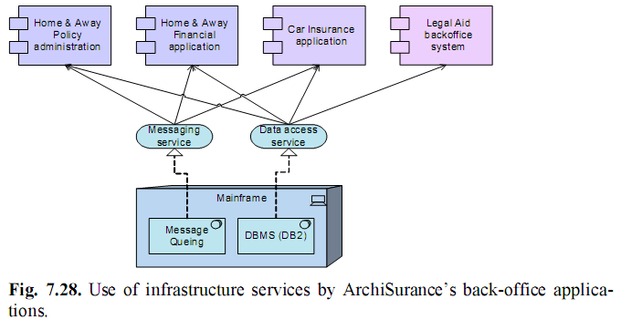
7.5.15 Infrastructure Usage Viewpoint

Slide 65
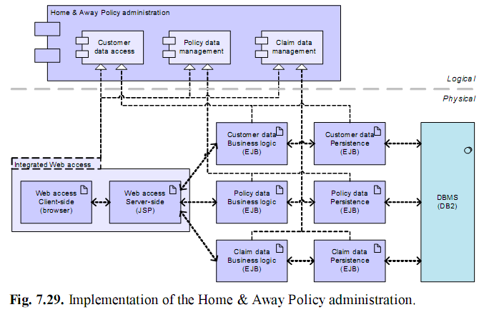
7.5.16 Implementation & Deployment Viewpoint

Slide 66
7.6 Summary
In this approach views are specified by viewpoints, which define abstractions on the set of models representing the enterprise architecture, each aimed at a particular type of stakeholder and addressing a particular set of concerns.

